Slide 1
PROFESSOR VELAZQUEZ
INTRODUCTION
TO
MICROECONOMICS
MODULE 03 · SUPPLY AND DEMAND EQUILIBRIUM
FALL 2025

Slide 2
03
Supply and Demand
Equilibrium
Section I builds the market model from consumer and producer data — table to equation to graph. Section II shifts it: the determinants of demand and supply, the ceteris paribus procedure, and the indeterminacy of double shifts.
MODULE

Slide 3
MODULE 3
Agenda, Big Questions & Do Now
BIG QUESTIONS
PRE-WORK
WHAT YOU'LL NEED
(1) How do consumers rank competing bundles of goods, and what determines where they choose to be?
(2) How do dispersed prices coordinate buyers and sellers without any central authority directing them?
(3) What happens to the equilibrium outcome when a social, political, or ecological force shifts supply or demand — or both simultaneously?
· Read Chapters 4–5 (Market Forces of Supply and Demand)
· Complete the Module 3 Vocabulary Checklist
· Khan Academy: Supply and Demand, Quizzes 1–3 — reach mastery
· Bring the Module 3 Worksheet and graph paper
· Module 3 Worksheet (printed)
· Pencil, straight-edge, calculator
· Graph paper — you will draw at least six labeled diagrams today
· Laptop for the classroom Market Model app and the MRU interactive practice
DO NOW · OPENING INQUIRY
In Module 2 you built the Feasible Frontier — the CONSTRAINT side of choice. Today we construct the PREFERENCE side, aggregate individual demand, pair it with supply, and discover how decentralized price signals coordinate millions of strangers. Open the Market Model app and draw the market for dates.
AGENDA — DAY 1 · BUILDING THE MODEL | TIME | AGENDA — DAY 2 · SHIFTING THE MODEL | TIME
Do Now + Module 2 bridge | 10 min | Do Now: classify five events | 5 min
Part 1 — Law of demand; the demand model | 30 min | Part 4 — Determinants of demand (TRIBE) and supply (PROFIT) | 35 min
Part 2 — Law of supply; the supply model | 25 min | Part 5 — Double shifts and three historical cases | 30 min
Part 3 — Equilibrium, algebraic and graphical | 10 min | You Try + independent practice | 5 min
INTRO TO MICROECONOMICS | PROF. VELAZQUEZ
MODULE 3: SUPPLY AND DEMAND EQUILIBRIUM

Slide 4
BEFORE WE BEGIN
Vocabulary Checklist — Module 3
Utility · Total Utility
Marginal Utility
Law of Diminishing MU
Optimal Consumption Rule
Indifference Curve
Marginal Rate of Substitution
Diminishing MRS
Optimal Bundle
MRS = Px/Py
Law of Demand
Law of Supply
Quantity Demanded
Quantity Supplied
Shift in Demand
Shift in Supply
Market Equilibrium
Equilibrium Price (P*)
Equilibrium Quantity (Q*)
Market-Clearing Price
Shortage · Surplus
Normal Good
Inferior Good
Substitute Goods
Complementary Goods
TRIBE · PROFIT
NOTE THE FIRST NINE TERMS
They are Module 2's consumer-choice vocabulary. They are on this list because the DEMAND CURVE is built from them — every point on a demand curve is a consumer's optimal bundle at that price.
INTRO TO MICROECONOMICS | PROF. VELAZQUEZ
MODULE 3: SUPPLY AND DEMAND EQUILIBRIUM

Slide 5
SECTION I
Building the Market Model
Part 1 · The law of demand and the linear demand model: table → equation → graph
Part 2 · The law of supply and the linear supply model: table → equation → graph
Part 3 · Market equilibrium, determined algebraically and graphically

Slide 6
BRIDGE FROM MODULE 2
Where the Demand Curve Comes From
1
START AT THE OPTIMAL BUNDLE
2
CHANGE THE PRICE, RE-OPTIMIZE
3
SUM HORIZONTALLY
In Module 2 each consumer chose the bundle where MRS = Px/Py — the tangency of the budget line and the highest attainable indifference curve. That tangency yields ONE quantity of good X at ONE price.
Lower Px and the budget line rotates outward. The consumer re-optimizes at a new tangency, choosing a different quantity of X. Repeat for every price and you trace out the INDIVIDUAL DEMAND CURVE.
Add the quantity every consumer demands at each price. That horizontal summation is the MARKET DEMAND CURVE — the curve we will treat as a primitive from here on.
THE SUBSTITUTION EFFECT
THE INCOME EFFECT
When Px falls, X becomes cheaper RELATIVE to other goods, so the consumer substitutes toward X. This effect always pushes quantity demanded in the opposite direction from price — it is what guarantees the law of demand.
When Px falls, real purchasing power rises — the same nominal income now commands a larger bundle. For a NORMAL good this reinforces the substitution effect; for an INFERIOR good it opposes it.
THE POINT OF THIS SLIDE
The demand curve is not an assumption. It is a THEOREM derived from constrained optimization — which is exactly why Module 2 had to come first, and why Module 2's vocabulary is on today's checklist.
INTRO TO MICROECONOMICS | PROF. VELAZQUEZ
MODULE 3: SUPPLY AND DEMAND EQUILIBRIUM

Slide 7
01
The Law of Demand
& the Demand Curve
PART
OBJECTIVE Apply the law of demand; construct a linear demand model from consumer data — table to equation to graph — and interpret its slope and intercepts.
INTRO TO MICROECONOMICS | PROF. VELAZQUEZ
MODULE 3: SUPPLY AND DEMAND EQUILIBRIUM

Slide 8
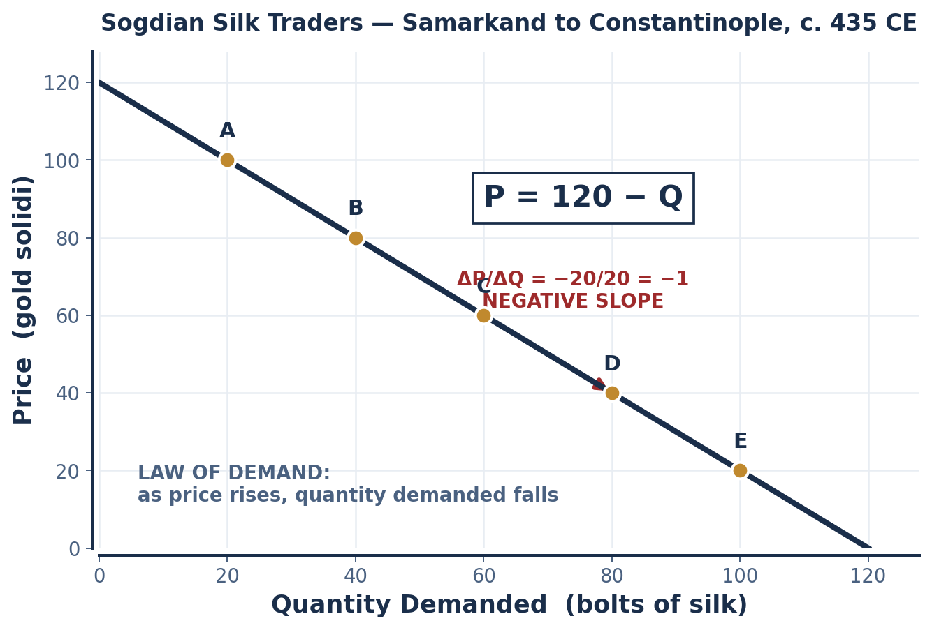
SCENARIO 3.1 · SILK ROAD, SAMARKAND TO CONSTANTINOPLE, C. 435 CE
Sogdian Silk Traders — Building a Demand Model
The Silk Road connected the peoples of Eurasia for centuries. In 435 CE the Sogdian merchant Nanai-dhat — Sogdians were the trusted neutral parties between the Byzantine and Sassanid Empires — recorded silk transaction data in gold solidi while journeying between trading posts. The data has been 'teleported' forward to us nearly 1,600 years later.
POINT | PRICE (gold solidi) | Qd (bolts of silk) | ΔQ | ΔP
A | 100 | 20 | n/a | n/a
B | 80 | 40 | +20 | −20
C | 60 | 60 | +20 | −20
D | 40 | 80 | +20 | −20
E | 20 | 100 | +20 | −20
P = 120 − Q ⟺ Qd = 120 − P
Slope ΔP/ΔQ = −20/+20 = −1. Vertical intercept (choke price) = 120. Horizontal intercept = 120.
LAW OF DEMAND
As price rises, quantity demanded falls — ceteris paribus.
INTRO TO MICROECONOMICS | PROF. VELAZQUEZ
MODULE 3: SUPPLY AND DEMAND EQUILIBRIUM

Slide 9
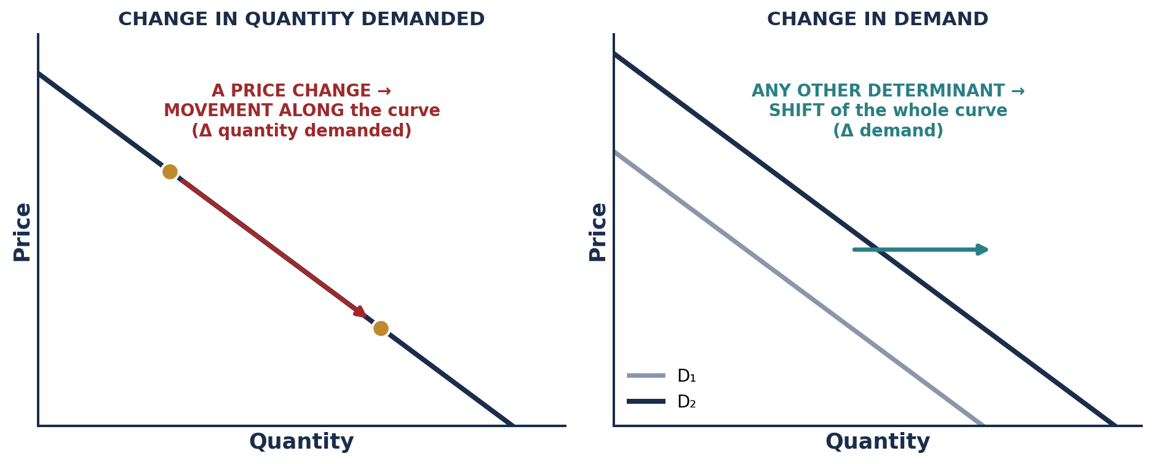
PART 1 · THE CRITICAL DISTINCTION
Quantity Demanded vs. Demand
CHANGE IN QUANTITY DEMANDED
CHANGE IN DEMAND
RULE OF THUMB
PRICE CHANGE = movement ALONG the curve.
ANYTHING ELSE = SHIFT of the curve.
This single rule accounts for more lost exam points than any other idea in the course.
Caused by a change in the good's OWN PRICE. It is a MOVEMENT ALONG a fixed demand curve — from one point to another on the same line.
Caused by any determinant OTHER than the good's own price. It is a SHIFT of the entire curve — a new line. RIGHT = increase, LEFT = decrease.
INTRO TO MICROECONOMICS | PROF. VELAZQUEZ
MODULE 3: SUPPLY AND DEMAND EQUILIBRIUM

Slide 10
02
The Law of Supply
& the Supply Curve
PART
OBJECTIVE Apply the law of supply; construct a linear supply model from producer data — table to equation to graph — and interpret its slope and intercepts.
INTRO TO MICROECONOMICS | PROF. VELAZQUEZ
MODULE 3: SUPPLY AND DEMAND EQUILIBRIUM

Slide 11
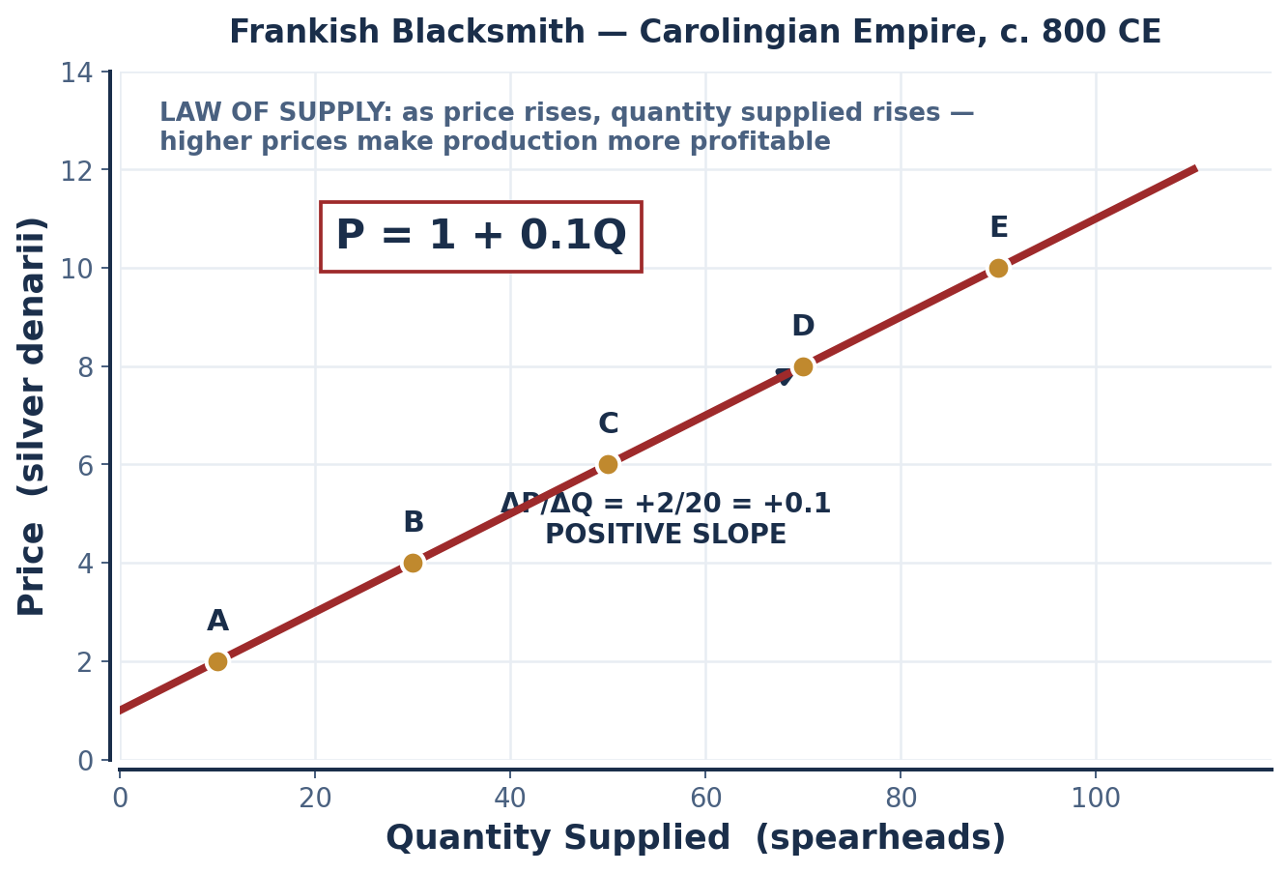
SCENARIO 3.2 · CAROLINGIAN EMPIRE, C. 800 CE
The Frankish Blacksmith — Building a Supply Model
When Charlemagne was crowned emperor on Christmas Day 800 CE, his military campaigns created massive demand for iron spearheads. A blacksmith in the imperial workshops recorded his willingness to supply at different prices, measured in silver denarii.
POINT | PRICE (silver denarii) | Qs (spearheads) | ΔQ | ΔP
A | 2 | 10 | n/a | n/a
B | 4 | 30 | +20 | +2
C | 6 | 50 | +20 | +2
D | 8 | 70 | +20 | +2
E | 10 | 90 | +20 | +2
P = 1 + 0.1 Q ⟺ Qs = 10 P − 10
Slope ΔP/ΔQ = +2/+20 = +0.1. Vertical intercept = 1 — the reservation price below which nothing is supplied.
LAW OF SUPPLY
As price rises, quantity supplied rises — because higher prices make production more profitable at the margin. The upward slope is really rising marginal cost, a claim Module 9 will prove.
INTRO TO MICROECONOMICS | PROF. VELAZQUEZ
MODULE 3: SUPPLY AND DEMAND EQUILIBRIUM

Slide 12
03
Market Equilibrium —
Algebraic & Graphical
PART
OBJECTIVE Determine market equilibrium algebraically and graphically; interpret what market-clearing means — and what it does not mean.
INTRO TO MICROECONOMICS | PROF. VELAZQUEZ
MODULE 3: SUPPLY AND DEMAND EQUILIBRIUM

Slide 13
PART 3 · THE FORMAL APPARATUS
Equilibrium: Symbols, Definitions and the Solution Method
THE DEMAND EQUATION
THE SUPPLY EQUATION
Qd = αd − βd · P
αd (alpha-d) = the demand INTERCEPT — quantity demanded when P = 0.
βd (beta-d) = the demand SLOPE — the rate at which Qd falls as P rises. Always positive as written, because the minus sign carries the law of demand.
Qs = αs + βs · P
αs (alpha-s) = the supply INTERCEPT — quantity supplied when P = 0. It CAN be negative, which simply means nothing is supplied below some reservation price.
βs (beta-s) = the supply SLOPE — the rate at which Qs rises as P rises.
Set Qd = Qs : αd − βd·P = αs + βs·P → P* = ( αd − αs ) / ( βd + βs )
Then substitute P* back into EITHER equation to obtain Q*. Check your answer in the OTHER equation — if the two disagree, you have made an arithmetic error.
CONDITION | WHAT HAPPENS IN THE MARKET | THE PRICE SIGNAL
P = P* | Qd = Qs. The market CLEARS: every buyer willing to pay P* finds a seller, and every seller willing to sell at P* finds a buyer. | No pressure. The market is at rest.
P > P* | Qs > Qd — a SURPLUS (excess supply) equal to Qs − Qd. Unsold inventory accumulates. | Downward pressure on price; price falls toward P*.
P < P* | Qd > Qs — a SHORTAGE (excess demand) equal to Qd − Qs. Buyers queue; shelves empty. | Upward pressure on price; price rises toward P*.
INTRO TO MICROECONOMICS | PROF. VELAZQUEZ
MODULE 3: SUPPLY AND DEMAND EQUILIBRIUM

Slide 14
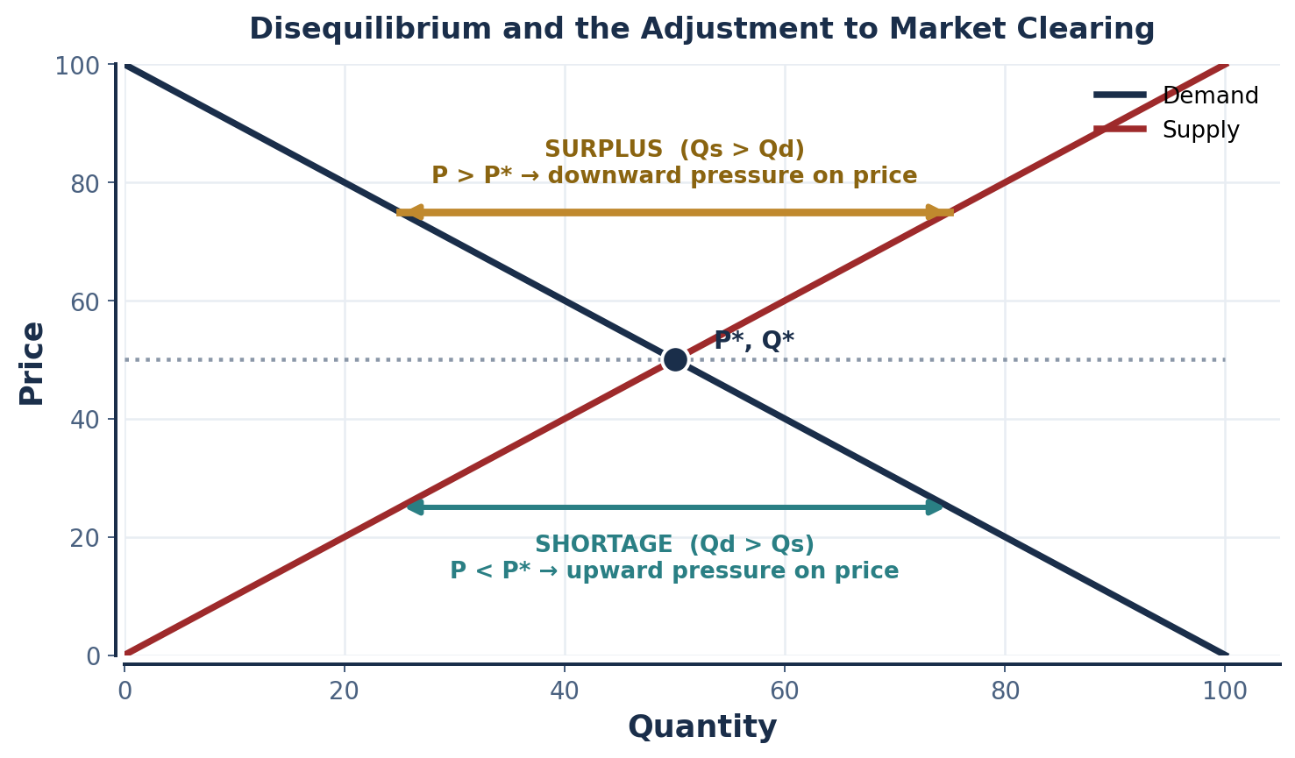
PART 3 · THE ADJUSTMENT MECHANISM
Adam Smith's Invisible Hand
THE INVISIBLE HAND
No central planner is needed. Individual self-interest — buyers seeking the lowest price, sellers seeking the highest — pushes the market toward equilibrium "as if guided by an invisible hand."
Smith (1776), Wealth of Nations, Book IV, Chapter II.
WHAT MARKET-CLEARING MEANS
It means Qd = Qs at the going price — no unsatisfied buyer at that price, no unsold unit at that price.
IT DOES NOT MEAN: that everyone who NEEDS the good gets it; that the distribution is fair; that the price is affordable; or that the outcome is just. Clearing is an accounting identity, not a moral verdict.
HAYEK'S ADDITION (1945)
The price is doing something no planner could: aggregating dispersed local knowledge — every buyer's private valuation and every seller's private cost — into a single number that no one had to know in advance.
INTRO TO MICROECONOMICS | PROF. VELAZQUEZ
MODULE 3: SUPPLY AND DEMAND EQUILIBRIUM

Slide 15
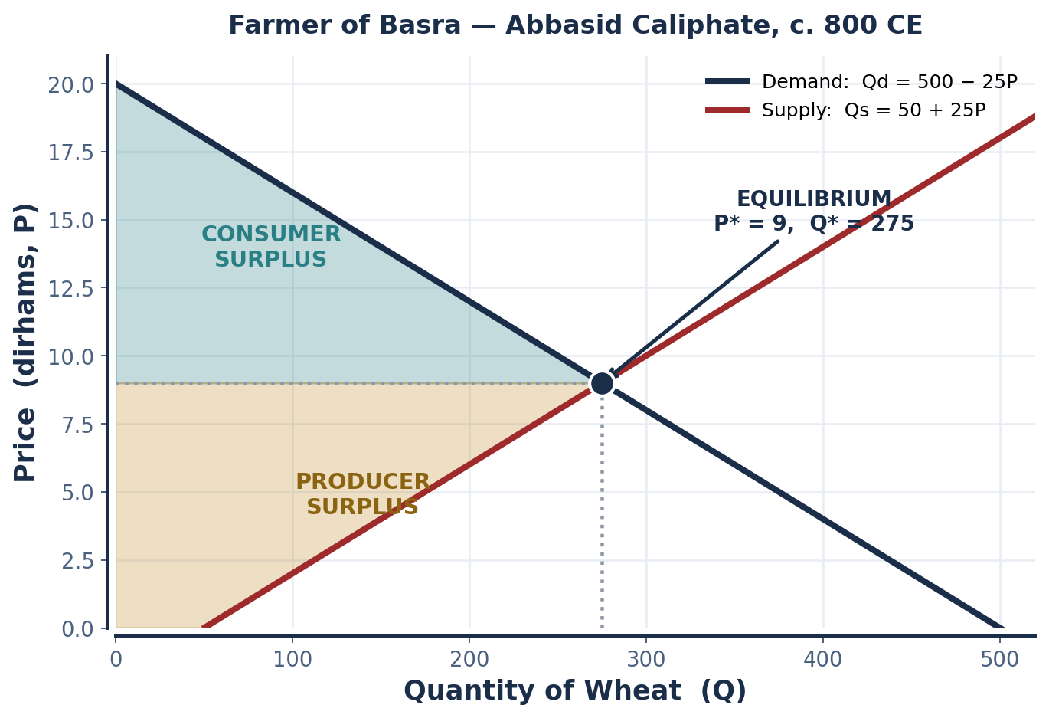
SCENARIO 3.3 · ABBASID CALIPHATE, IRAQ, C. 800 CE
The Farmer of Basra — Solving for Equilibrium
In 800 CE the Abbasid Caliphate governed the fertile lands around Basra, a thriving port at the mouth of the Tigris and Euphrates. Abbasid scholars — al-Khwārizmī among them — were introducing the algebraic methods we are about to use.
Qd = 500 − 25P Qs = 50 + 25P
500 − 25P = 50 + 25P
450 = 50P
P* = 9
Q* = 500 − 25(9) = 275
CHECK: Qs = 50 + 25(9) = 275 ✓
READING THE SURPLUS TRIANGLES
CONSUMER SURPLUS: the area ABOVE P* and BELOW the demand curve — what buyers were willing to pay minus what they actually paid. Here: ½ × 275 × (20 − 9) = 1,512.5.
PRODUCER SURPLUS: the area BELOW P* and ABOVE the supply curve — what sellers received minus their willingness to sell. Here: ½ × 275 × (9 − 2) = 962.5.
We formalize both in Module 5.
INTRO TO MICROECONOMICS | PROF. VELAZQUEZ
MODULE 3: SUPPLY AND DEMAND EQUILIBRIUM

Slide 16
PART 3 · WORKSHEET ✦2
Efficient Clearing, Unequal Outcomes
THE QUESTION
Market equilibrium maximizes TOTAL surplus — but it does not guarantee a just or equitable DISTRIBUTION of that surplus. Using Marcus and Ray's neighborhood as your context, explain how a market can "clear" efficiently while generating profoundly unequal outcomes for the participants.
1
EFFICIENCY IS ABOUT SIZE
2
WILLINGNESS ≠ NEED
3
WHO SETS THE CURVE
Total surplus is the size of the pie: consumer surplus plus producer surplus. Equilibrium maximizes that total. But a maximum total is consistent with ANY division of that total between buyers and sellers — the model is silent on the split.
Demand measures willingness AND ABILITY to pay. A household that needs housing desperately but cannot pay P* simply does not appear in the demand curve. The market clears precisely by excluding them — and records no failure in doing so.
Ray owns the commercial property; Marcus sells his labor. Both face a clearing market. But Ray's surplus derives from an asset whose supply is fixed, while Marcus's derives from an input he must reproduce daily. Same equilibrium, entirely different position within it.
EFFICIENCY is a positive claim. EQUITY is a normative claim.
Module 1 taught you to keep these apart. Module 5 will measure efficiency precisely. Modules 7 and 8 will ask who captured the surplus — and why.
INTRO TO MICROECONOMICS | PROF. VELAZQUEZ
MODULE 3: SUPPLY AND DEMAND EQUILIBRIUM

Slide 17
SECTION II
Shifting the Market Model
Part 4 · All determinants of demand (TRIBE) and supply (PROFIT); the ceteris paribus procedure
Part 5 · Simultaneous double shifts and the four-case indeterminacy framework
Part 5 · Three canonical historical case studies: the Black Death, COVID-19, and the 1973 OPEC embargo

Slide 18
04
Determinants of
Demand & Supply
PART
OBJECTIVE Enumerate all determinants of demand and supply; explain the ceteris paribus procedure; classify any event as a shift or a movement along.
INTRO TO MICROECONOMICS | PROF. VELAZQUEZ
MODULE 3: SUPPLY AND DEMAND EQUILIBRIUM

Slide 19
PART 4 · TRIBE
The Five Determinants of Demand
 | DETERMINANT | THE RULE | HISTORICAL / CONTEMPORARY EXAMPLE
T | TASTES & PREFERENCES (cultural, religious, fashion, technology) | A favorable shift in taste → D shifts RIGHT. An unfavorable shift → D shifts LEFT. | The Chinese court adopts ivory as a status symbol → D for ivory RIGHT. A study warns against a product → D LEFT.
R | PRICES OF RELATED GOODS (substitutes and complements) | SUBSTITUTE: price of the substitute ↑ → D for this good RIGHT (buyers switch in). COMPLEMENT: price of the complement ↑ → D for this good LEFT (goods used together). | Price of tea rises → demand for coffee rises (substitutes). Price of gasoline rises → demand for large cars falls (complements).
I | INCOME (normal vs. inferior goods) | NORMAL GOOD: income ↑ → D RIGHT. INFERIOR GOOD: income ↑ → D LEFT. The relationship is INVERSE. | Gold trade booms and Indian merchants grow wealthier → demand for ivory (normal) rises. Incomes rise → demand for instant noodles (inferior) falls.
B | BUYER COUNT (number of buyers / market size) | More buyers in the market → D RIGHT. Fewer buyers → D LEFT. The POPULATION of your data matters. | Indian Ocean trade networks expand → entirely new groups of buyers enter the Kilwa ivory market. Persian merchants lose their fleet → fewer buyers → D LEFT.
E | EXPECTATIONS (future prices, availability) | Buyers expect prices to RISE next period → buy more NOW → current D RIGHT. Expect prices to FALL → current D LEFT. | News and weather reports cause households to hoard toilet paper and bread. Buyers expect ivory prices to double next season → buy now.
NORMAL vs. INFERIOR — formal
SUBSTITUTES vs. COMPLEMENTS — formal
THE ONE EXCLUSION
A good is NORMAL if demand rises with income (∂D/∂I > 0) and INFERIOR if demand falls with income (∂D/∂I < 0). Inferiority is not a claim about quality — it is a claim about the sign of one derivative.
SUBSTITUTES: ∂Dx/∂Py > 0 — a rise in the other good's price raises demand for this one. COMPLEMENTS: ∂Dx/∂Py < 0. Module 4 measures both with the CROSS-PRICE ELASTICITY.
The good's OWN price is NOT on this list, and never will be. Own price is the variable on the vertical axis — changing it moves you along the curve you already drew.
WHAT IS EXOGENOUS TO THE DEMAND MODEL
Everything on this list. Price is ENDOGENOUS — it is determined inside the model, so a price change moves you along the curve. Everything else comes from outside, and therefore moves the curve itself.
INTRO TO MICROECONOMICS | PROF. VELAZQUEZ
MODULE 3: SUPPLY AND DEMAND EQUILIBRIUM

Slide 20
PART 4 · PROFIT
The Six Determinants of Supply
 | DETERMINANT | THE RULE | HISTORICAL / CONTEMPORARY EXAMPLE
P | PRICES OF INPUTS (costs of production) | Higher input costs (iron, wood, wages) → S shifts LEFT. Lower input costs → S shifts RIGHT. | Ray raises commercial rents → the supply of neighborhood goods falls. Wages rise for suppliers → S LEFT.
R | RELATED GOODS IN PRODUCTION | If a producer can switch output, a rise in the price of the alternative good → S of this good LEFT. | A farmer who can plant wheat or barley shifts acreage to whichever price has risen.
O | OTHER PRODUCERS (number of sellers) | More producers enter → S RIGHT. Producers exit → S LEFT. | New workshops open in the Carolingian imperial forges → S of spearheads RIGHT.
F | FUTURE EXPECTATIONS | Expect higher prices later → withhold supply now → current S LEFT. Expect lower prices → release supply now → current S RIGHT. | Blacksmiths expecting a new campaign hold back inventory until prices rise.
I | INNOVATION (technology / productivity) | Better tools or methods → MORE OUTPUT FROM THE SAME INPUTS → S RIGHT. Technological setbacks → S LEFT. | Water-powered trip hammers raise iron output per worker → S RIGHT.
T | TAXES & SUBSIDIES (government policy) | A tax raises production cost → S LEFT. A subsidy lowers cost → S RIGHT. | An imperial levy on iron → S LEFT. A grain subsidy → S RIGHT. Formalized in Module 5.
+ | NATURAL & EXTERNAL CONDITIONS | Favorable weather, good harvests, resource discoveries → S RIGHT. Drought, disease, war → S LEFT. | Ideal rains bring a bumper tea harvest in Song Hangzhou → S RIGHT. Cacao harvest failure near Tenochtitlan → S LEFT.
THE MNEMONICS
DEMAND = TRIBE: Tastes / Related prices / Income / Buyer count / Expectations. SUPPLY = PROFIT: Prices of inputs / Related goods / Other producers / Future expectations / Innovation / Taxes and subsidies.
INTRO TO MICROECONOMICS | PROF. VELAZQUEZ
MODULE 3: SUPPLY AND DEMAND EQUILIBRIUM

Slide 21
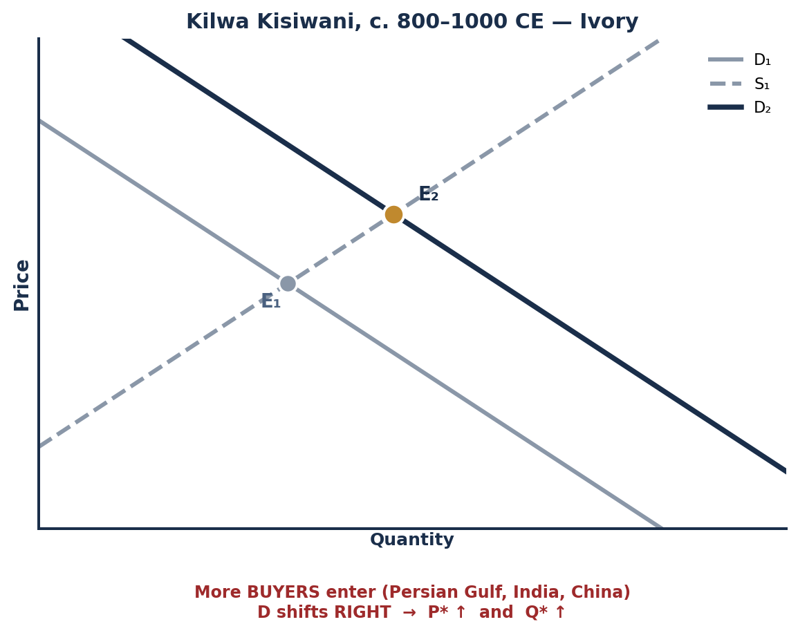
SCENARIO 3.4 · KILWA KISIWANI, C. 800–1000 CE
The Merchant of Kilwa — A Demand Shift Worked Through
By 800 CE Kilwa Kisiwani (modern Tanzania) had emerged as a key Swahili trading port on the East African coast, where Gujarati textile traders and Abbasid spice merchants competed for ivory. As Indian Ocean trade networks expanded, demand from the Persian Gulf, India and China for East African ivory surged. This was an INCREASE IN DEMAND — entirely new groups of buyers entered the market, willing to buy at every price level.
1. WHICH DETERMINANT?
BUYER COUNT (the B in TRIBE) — new groups of buyers entered the market. Secondarily TASTES, as the Chinese court adopted ivory as a status good, and INCOME, as gold-trade wealth rose among Indian merchants.
3. THE NEW EQUILIBRIUM
P₂* is HIGHER than P₁*. Q₂* is HIGHER than Q₁*. Supply is unchanged — we move ALONG the fixed supply curve to a new intersection.
4. CLASSIFY EACH EVENT | SHIFT or ALONG? | DIRECTION
Price of ivory rises from 10 to 15 gold coins per tusk | ALONG | ↓ quantity demanded
Chinese court adopts ivory as a status symbol (new taste) | SHIFT | → D RIGHT
Persian merchants lose their trading fleet (fewer buyers) | SHIFT | ← D LEFT
Buyers expect ivory prices to double next season | SHIFT | → D RIGHT
Gold trade booms — Indian merchants grow wealthier | SHIFT | → D RIGHT (normal good)
INTRO TO MICROECONOMICS | PROF. VELAZQUEZ
MODULE 3: SUPPLY AND DEMAND EQUILIBRIUM

Slide 22
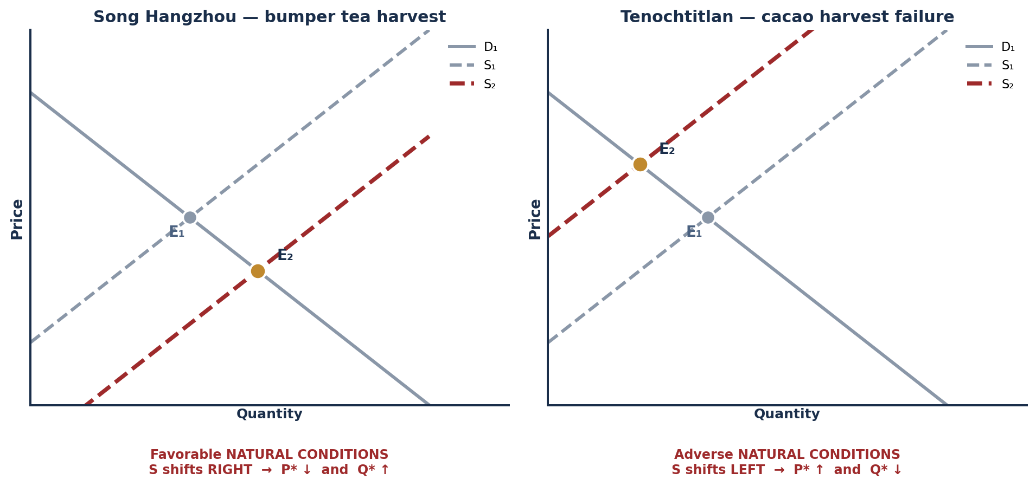
PART 4 · SUPPLY SHIFTS IN HISTORY
Song Hangzhou & Tenochtitlan — Two Supply Shocks
SONG HANGZHOU — A BUMPER TEA HARVEST
TENOCHTITLAN — CACAO HARVEST FAILURE
A year of ideal rains brings a bumper harvest. Farmers deliver far more leaves to market: S shifts RIGHT. Prices FALL as stalls overflow, making tea accessible to ordinary townspeople. Consumers benefit — but small growers face slimmer margins, and merchants look to canal and maritime trade to move the surplus.
Cacao beans served as both currency and the basis of ritual chocolate. Seasonal rains fail; far fewer beans reach the city: S shifts LEFT and prices RISE. Ordinary households and lower-status warriors can no longer afford cacao drinks while nobles and priests still buy for ceremonies. A negative supply shock raises prices, restricts access, and AMPLIFIES SOCIAL DIVISION.
INTRO TO MICROECONOMICS | PROF. VELAZQUEZ
MODULE 3: SUPPLY AND DEMAND EQUILIBRIUM

Slide 23
05
Double Shifts &
Historical Case Studies
PART
OBJECTIVE Analyze simultaneous double shifts using the ceteris paribus procedure and three canonical historical case studies; identify which outcomes are determinate and which are ambiguous.
INTRO TO MICROECONOMICS | PROF. VELAZQUEZ
MODULE 3: SUPPLY AND DEMAND EQUILIBRIUM

Slide 24
PART 5 · CETERIS PARIBUS PROCEDURE
How to Think With Two Things Happening at Once
Think like an economist: ISOLATE ONE FORCE AT A TIME, then analyze the change. Think of the two shifts as COMPETING SOCIAL FORCES.
STEP | WHAT YOU DO
1 | Establish the BASELINE. Draw D₁ and S₁; mark E₁ and read off market price (Pm) and market quantity (Qm).
2 | Analyze the change to DEMAND alone. Which determinant? Which direction? Mark the effect on P and Q holding supply fixed.
3 | Analyze the change to SUPPLY alone. Which determinant? Which direction? Mark the effect on P and Q holding demand fixed.
4 | Combine. Where the two forces AGREE on a variable, that outcome CAN be determined. Where they COMPETE, it CANNOT be determined without knowing the relative magnitudes.
DOUBLE-SHIFT FRAMEWORK | EFFECT ON P* | EFFECT ON Q*
D shifts RIGHT, S shifts RIGHT | AMBIGUOUS — depends on relative magnitudes | UNAMBIGUOUS: Q* ↑
D shifts LEFT, S shifts LEFT | AMBIGUOUS — depends on relative magnitudes | UNAMBIGUOUS: Q* ↓
D shifts RIGHT, S shifts LEFT | UNAMBIGUOUS: P* ↑ | AMBIGUOUS — depends on relative magnitudes
D shifts LEFT, S shifts RIGHT | UNAMBIGUOUS: P* ↓ | AMBIGUOUS — depends on relative magnitudes
THE PATTERN WORTH MEMORIZING
SAME DIRECTION shifts → QUANTITY is determinate, price ambiguous. OPPOSITE DIRECTION shifts → PRICE is determinate, quantity ambiguous.
INTRO TO MICROECONOMICS | PROF. VELAZQUEZ
MODULE 3: SUPPLY AND DEMAND EQUILIBRIUM

Slide 25
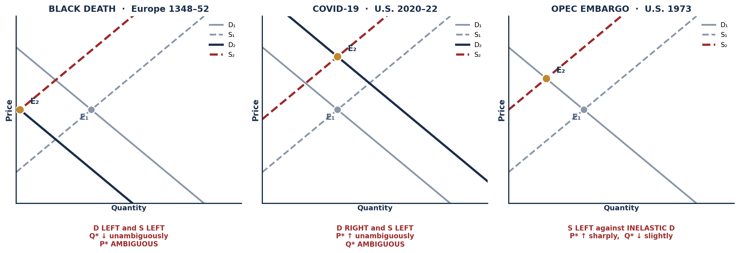
PART 5 · THREE CANONICAL CASES
The Black Death · COVID-19 · The OPEC Embargo
SCENARIO 3.5 — BLACK DEATH, 1348–52
SCENARIO 3.6 — COVID-19, 2020–22
SCENARIO 3.7 — OPEC EMBARGO, 1973
Plague killed roughly one-third of Europe. D LEFT (far fewer buyers) and S LEFT (far fewer farmers and artisans; fields fallow, workshops silent). Q* fell UNAMBIGUOUSLY. P* was AMBIGUOUS — grain prices sometimes fell, while wages for surviving laborers rose sharply as landowners competed for scarce workers.
Factory closures and semiconductor shortages shifted S sharply LEFT. Fiscal stimulus and substitution away from services shifted D RIGHT. P* rose UNAMBIGUOUSLY — sustained 7–9% inflation. Q* was AMBIGUOUS. Both demand-pull and cost-push forces operated at once.
OPEC embargoed production: S of petroleum — and of every good made with it — shifted sharply LEFT. Short-run demand was highly INELASTIC. P* rose sharply; Q* fell only slightly. Downstream: cars, plastics and fertilizers all became costlier.
INTRO TO MICROECONOMICS | PROF. VELAZQUEZ
MODULE 3: SUPPLY AND DEMAND EQUILIBRIUM

Slide 26
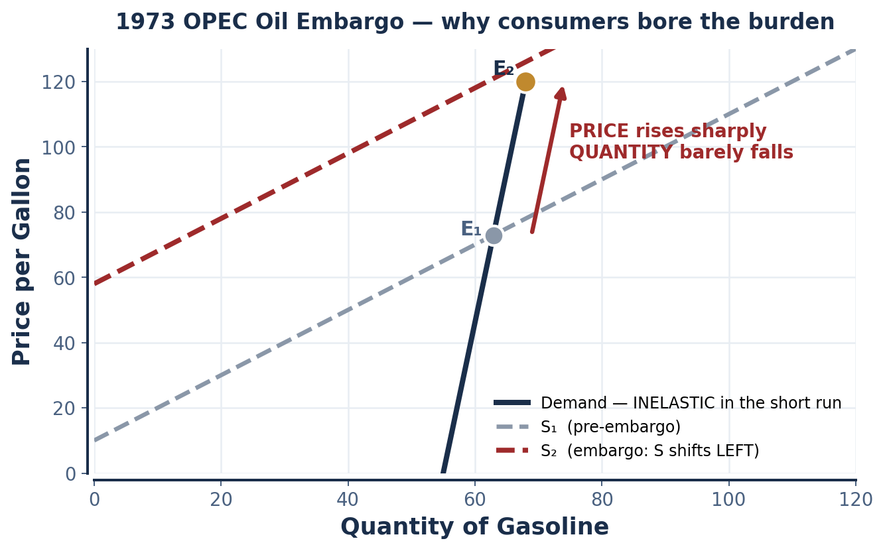
SCENARIO 3.7 · UNITED STATES, OCTOBER 1973
Why Consumers Bore the Burden of the Oil Shock
SHORT-RUN PED OF GASOLINE
INELASTIC. In the short run consumers have few immediate substitutes: the car is already owned, the commute is already fixed, the house is already heated with oil. Quantity demanded barely responds to price.
WHY CONSUMERS BORE THE BURDEN
When demand is far less elastic than supply, the side that CANNOT easily adjust absorbs most of the price change. Gasoline buyers could not adjust; so the leftward supply shift translated almost entirely into higher prices rather than lower quantities.
THE DOWNSTREAM EFFECT
Petroleum is an INPUT (the P in PROFIT) for cars, plastics and fertilizers. A supply shock in one factor market propagates as a cost shock into every product market that uses it — the first hint of the general-equilibrium reasoning we meet in Module 6.
FORWARD REFERENCE
The word ELASTICITY has now done real analytical work three times today. Module 4 makes it precise.
INTRO TO MICROECONOMICS | PROF. VELAZQUEZ
MODULE 3: SUPPLY AND DEMAND EQUILIBRIUM

Slide 27
PART 5 · WORKSHEET ✦3
COVID-19 — A Double Shift You Lived Through
THE QUESTION
The COVID-19 supply chain crisis is a double shift you lived through as a consumer. Which shift — supply or demand — do you believe exerted the larger effect on the prices you observed? What empirical evidence would you need to settle the question rigorously? What does this episode reveal about the limits of the partial equilibrium model?
1
THE CLASSIFICATION QUESTION
2
WHAT EVIDENCE WOULD SETTLE IT
3
LIMITS OF PARTIAL EQUILIBRIUM
DEMAND-PULL inflation: prices rise because buyers are chasing goods (stimulus, substitution from services). COST-PUSH inflation: prices rise because production got more expensive (freight rates, chips, labor shortages). Both were present; the empirical question is the relative magnitude.
Look at QUANTITY. If P rose AND Q rose, demand dominated. If P rose while Q FELL, supply dominated. Quantity is the discriminating variable — which is precisely why the double-shift framework says price alone is uninformative here.
Our model holds all OTHER markets fixed. In 2020–22 nothing else was fixed: labor, shipping, energy, semiconductors and housing all moved together, and each one's price was another's input cost. Partial equilibrium is a lens, not a photograph.
P ↑ and Q ↑ → DEMAND dominated. P ↑ and Q ↓ → SUPPLY dominated.
Write this rule on the inside cover of your notes. It converts an ambiguous price observation into a determinate diagnosis.
INTRO TO MICROECONOMICS | PROF. VELAZQUEZ
MODULE 3: SUPPLY AND DEMAND EQUILIBRIUM

Slide 28
YOU TRY
Module 3 — Independent Practice
Complete all five Parts of the Module 3 Worksheet, including every graph — axes, curves, intercepts, E₁ and E₂ all labeled.
Khan Academy: Supply and Demand Quizzes 1, 2 and 3 — reach mastery. Quiz 4 contains material we did not cover; treat it as exposure.
MRU interactive practice: the demand-vs-quantity-demanded deep review.
Answer reflection questions ✦2 and ✦3 in complete sentences.
HOMEWORK RULE OF THUMB: above 80% → move on. Below 80% → retry once or twice. Consistently below 80% → office hours, immediately.
20
MIN
INTRO TO MICROECONOMICS | PROF. VELAZQUEZ

Slide 29
MODULE 3
What You Should Be Able to Do
 | LEARNING OUTCOME
Part 1 | State the law of demand and explain it through the substitution and income effects; build a linear demand model from a data table in all three forms; compute the slope and both intercepts; distinguish a change in quantity demanded from a change in demand.
Part 2 | State the law of supply and explain the upward slope through rising marginal cost; build a linear supply model from producer data in all three forms; compute the slope and interpret the vertical intercept as a reservation price.
Part 3 | Solve Qd = Qs algebraically for P* and Q* and verify the solution in both equations; identify shortages and surpluses and predict the direction of price adjustment; explain what market clearing does and does NOT establish; shade and compute CS and PS.
Part 4 | Recite all five determinants of demand (TRIBE) and all six of supply (PROFIT); classify any event as a shift or a movement along, and state its direction; predict the effect on P* and Q* of any single-curve shift.
Part 5 | Execute the four-step ceteris paribus procedure for a double shift; state which of P* and Q* is determinate in each of the four cases and why; apply the framework to the Black Death, COVID-19 and the 1973 oil shock.
NEXT
MODULE 4 — SUPPLY AND DEMAND ELASTICITY. We have used the word 'elastic' informally three times today. Module 4 gives it a formula, a sign, a set of thresholds, and a direct link to total revenue.
INTRO TO MICROECONOMICS | PROF. VELAZQUEZ
MODULE 3: SUPPLY AND DEMAND EQUILIBRIUM

Slide 30
MODULE 3
References
Hayek, F. A. (1945). The use of knowledge in society. American Economic Review, 35(4), 519–530.
Marshall, A. (1890). Principles of economics. London: Macmillan.
Mankiw, N. G. (2021). Principles of microeconomics (9th ed.), Chs. 4–5. Cengage.
Hamilton, A. (1985). Wages and prices in Byzantium. Byzantine Studies Review.
de la Vaissière, É. (2005). Sogdian traders: A history. Leiden: Brill.
Herlihy, D. (1997). The Black Death and the transformation of the West. Harvard University Press.
Chuku, C., Samal, P., et al. (2023). Are we heading for another debt crisis? IMF Working Paper. (COVID-era price dynamics)
Hamilton, J. D. (2013). Historical oil shocks. In Routledge Handbook of Major Events in Economic History.
Chittick, N. (1974). Kilwa: An Islamic trading city on the East African coast. British Institute in Eastern Africa.
Smith, A. (1776). An inquiry into the nature and causes of the wealth of nations. London: W. Strahan & T. Cadell.
INTRO TO MICROECONOMICS | PROF. VELAZQUEZ
MODULE 3: SUPPLY AND DEMAND EQUILIBRIUM

